Slide 1
SOLID WASTE MANAGEMENT
Composting Municipal Solid Waste

Slide 2
INTRODUCTION
Composting Municipal Solid waste is rapidly growing in the United States
It includes Commercial, residential, commercial and institutional solid waste generated by the community
It’s the process that degrades biodegradable Municipal Solid Waste under aerobic conditions
Solid waste piles up quickly where individuals live, waste is a part of daily lives,, wrappers, spoilt food and other waste products
Notes:
In the current times, modernization of residential premises has brought about a corresponding pile of waste products, these products come from items that are used on a regular basis and therefore have the capacity to pile up fast. In cities and towns the population is quite high and therefore the need for a strategy of controlling the fast pile up is necessary. This helps in enhancing hygiene and control diseases that may arise from poor sanitation.

Slide 3
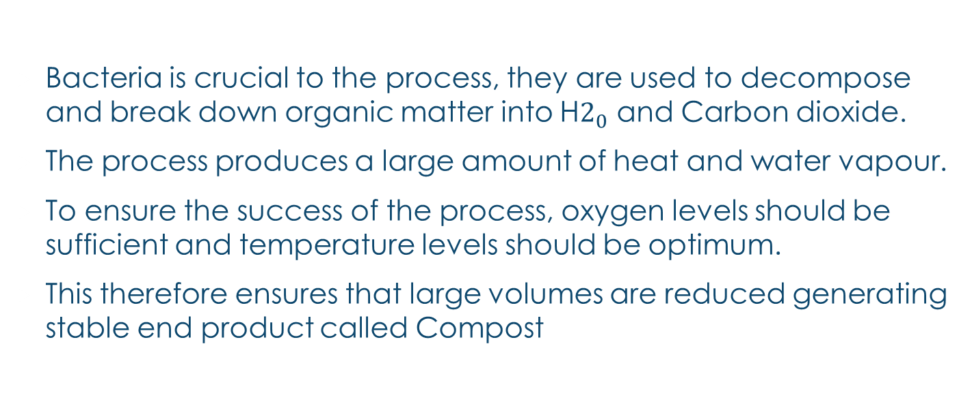
pROCEDURE
Bacteria is crucial to the process, they are used to decompose and break down organic matter into H$2_{0}$ and Carbon dioxide.
The process produces a large amount of heat and water vapour.
To ensure the success of the process, oxygen levels should be sufficient and temperature levels should be optimum.
This therefore ensures that large volumes are reduced generating stable end product called Compost
Notes:
To further understand the process of waste management we need to delve deeper into the procedure itself, to understand this we also look at the products and conditions required. For the process to work a couple of conditions are necessary, they include : Bacteria that breaks down organic matter, sufficient oxygen levels and optimum temperatures level.

Slide 4
COMPOSTING MUNICIPAL SOLID WASTE
The end product to the process: known as Compost is used for mulching, soil enhancement and soil enhancement.
Composting solid waste reduces the amount of waste that would have rather ended up in landfills
This concept has been used on small scale for centuries
Large scale solid waste management is however still at its early stage of development in the United States.
Notes:
Composting provides a strategy for reduction of large volumes of waste products, besides that its end product can be used in many other ways. It provides a solution to the crisis that is the filling of the lands that were being used as the deposits for solid waste. This therefore provides room for other developments in the lands, despite the fact that this process has existed it is still at its early stages of development on a large scale basis.

Slide 5
Examples
Municipal solid waste includes the following:
Food waste
Paper
Non-biodegradable materials include plastics and glass
Notes:
We take a look at some of the examples of waste products that are included in the Municipal Solid Waste scope. These include compostable materials such as food waste and paper.

Slide 6
COMPOSTING MUNICIPAL SOLID WASTE
The process may face challenges from the introduction of non compostable materials such as glass and plastics.
Such materials hinder the formation of uniform and homogeneous compost
In order to solve this challenge, the system must include techniques that remove the non compostable materials.
This happens through techniques such as presorting, screening, sifting and removal at the end of the process.
Notes:
To ensure the efficiency of the system challenges must be dealt with, these challenges include the presence of nonbiodegrable materials in the solid waste. A system is therefore necessary to ensure that it facilitates the removal of these materials at any point in the process. Some of these materials include glass and plastic materials.

Slide 7
METHODS
The most common methods of Municipal Solid Waste composting include:
Closed in vessel
Windrow
Static aerated pile composting
The choice of the method varies based on the volume of waste and the availability of space
Notes:
There are various methods of composting municipal solid waste, the choice to be made varies on the basis of the size of the waste and the space available for the process.

Slide 8
METHODS
Closed in vessel methods involves the physical containment of the Municipal Solid Waste within large drums or cylinders with supply of aeration and agitation.
In Windrows method the solid waste is piled in long rows of material approximately four to seven feet high with air and ventilation supply, the piles are flipped over with mechanical windrow turners
Static aerated compost piles does not involve physical agitation, instead air is supplied and excess heat removed through sensors and pipes.
Notes:
To take a deeper look at the process we need to delve deeper in the various methods that are included in the composting process, firstly the closed in vessel methods , secondly we also see the Windrows method and lastly we take a look at the Static aerated compost piles. We see how the methods work and the stages involved in their operation.

Slide 9
REQUIREMENTS
As we have seen while taking a look at the methods, all of them have specified on a couple of requirements for their efficiency these include:
Adequate oxygen levels, insufficient air supply leads to incomplete microbial action
Ventilation which facilitates the removal of excess heat and water.
If any of these requirements is not met and there is incomplete microbial action then decomposition is incomplete and as a result strong unpleasant odors may arise leading to the shutdown of the whole composting plant
Notes:
The composting process is a chemical reaction and therefore certain reactions should be met in order to ensure that the decomposition of the products is complete. An incomplete decomposition may lead to a total failure of the whole process, this is because it causes the pile to be anaerobic and therefore may result in strong unpleasant odors that may lead to complaints by those living near the plant.

Slide 10
REFERENCES
.
Wei, Y., Li, J., Shi, D., Liu, G., Zhao, Y., & Shimaoka, T. (2017). Environmental challenges impeding the composting of biodegradable municipal solid waste: A critical review. Resources, Conservation and Recycling, 122, 51-65.
Farrell, M., & Jones, D. L. (2009). Critical evaluation of municipal solid waste composting and potential compost markets. Bioresource technology, 100(19), 4301-4310.

